Slide 1
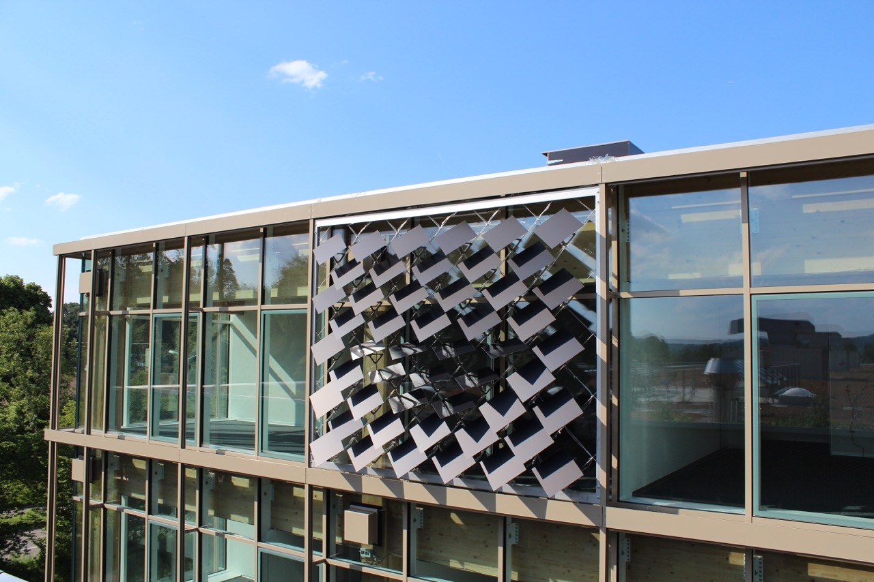
Numerical Energy Analysis of PV Modules as Adaptive Building Shading Systems
Jeremias Schmidli
Supervisor: Prageeth Jayathissa

Slide 2
The Adaptive Solar Façade (ASF)
Individually Actuated Panels
Combines Dynamic Shading with PV-Electricity Production
Needs to be Optimized for Cooling, Heating, Lighting and PV-Electricity Production

Slide 3
Overview
Introduction
Problem Description
Methodology
Results and Discussion
Conclusions and Outlook

Slide 4
Problem Description
Optimization Problem
Minimize: C + H + L – PV
C = Cooling Electricity Demand
H = Heating Electricity Demand
L = Lighting Electricity Demand
PV = Photovoltaic Electricity Production

Slide 5
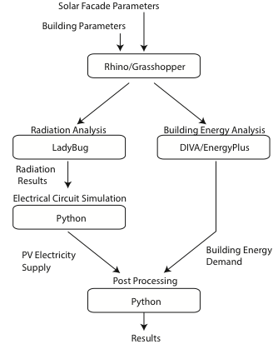
Methodology
Combination Of Different Tools To Achieve Optimal Results
Minimize: C + H + L – PV
Notes:
Add minimization problem

Slide 6
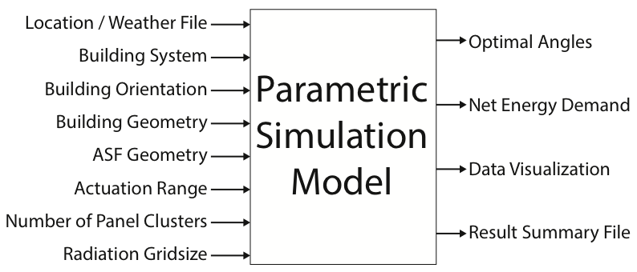
Parametric Model
Notes:
Add minimization problem

Slide 7
Case Study
Single Zone Office
Simulation for One Year
Weather File for Kloten-Zurich
Heating COP: 4
Cooling COP: 3
Lighting Load: 11.74 W/m²
Infiltration Rate: 1/h
Notes:
Add minimization problem

Slide 8
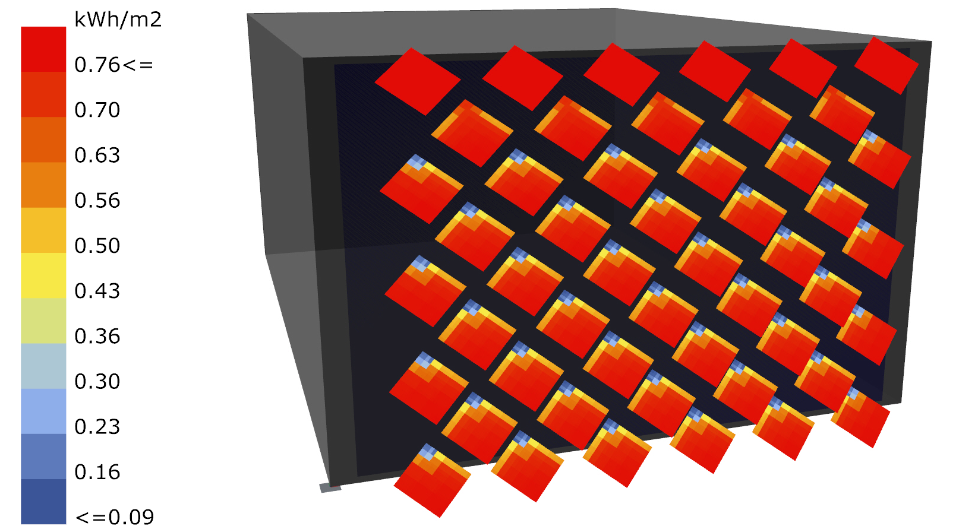
Radiation and PV analysis
(Collaboration with Johannes)
Radiation Analysis with Ladybug
Includes Self-Shading
Detailed PV simulation with Python
Insolation from 12:00-13:00 on August 11

Slide 9
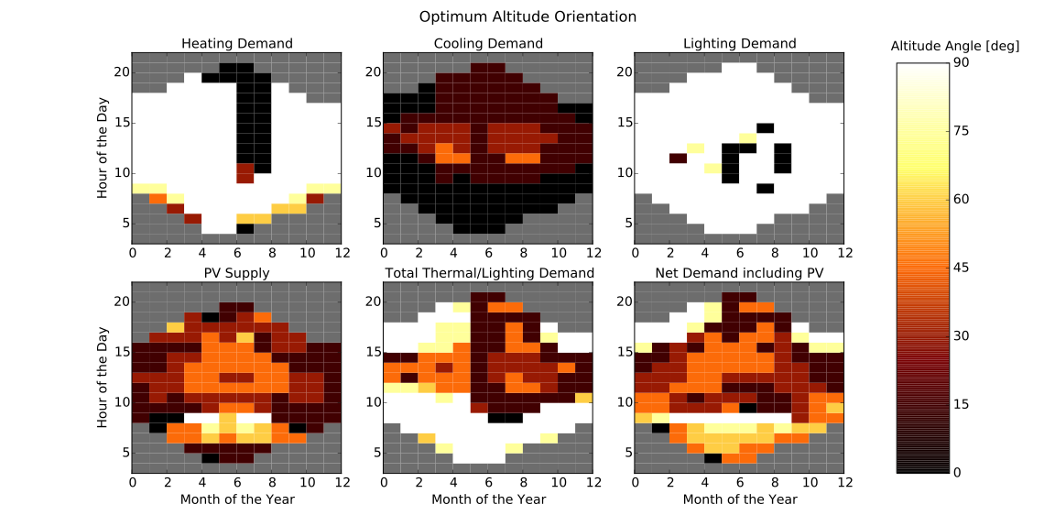
Optimum Altitude Angles of Panels

Slide 10
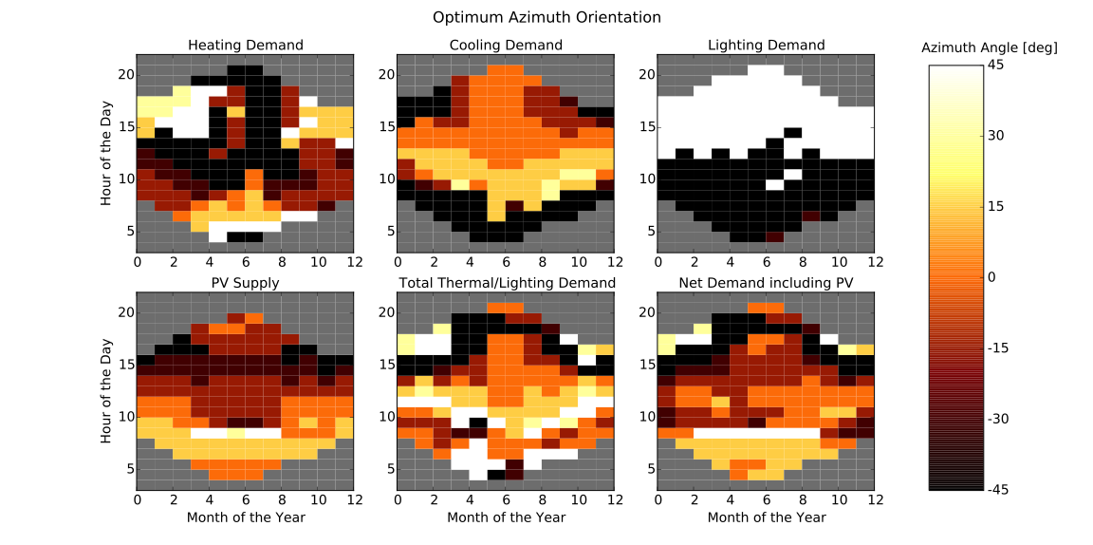
Optimum Azimuth Angles of Panels

Slide 11
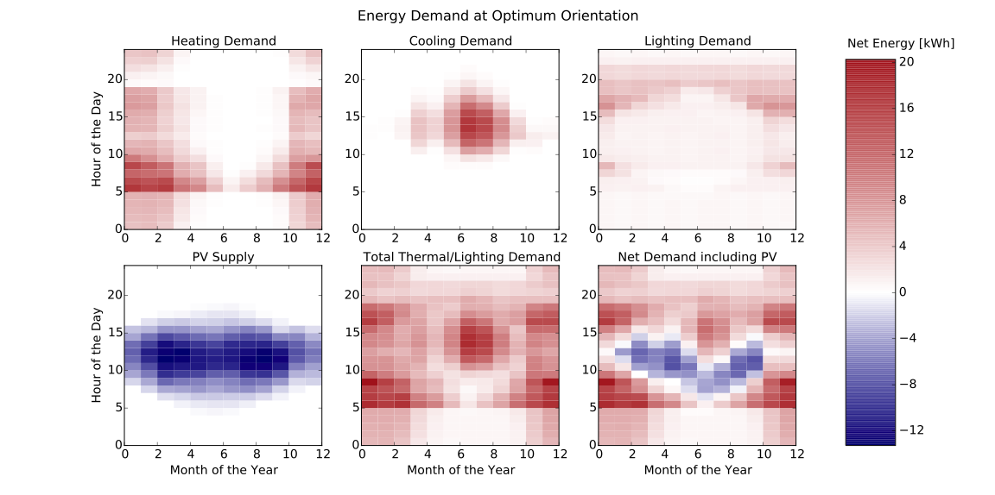
Net Energy Demand at Optimum Orientation

Slide 12
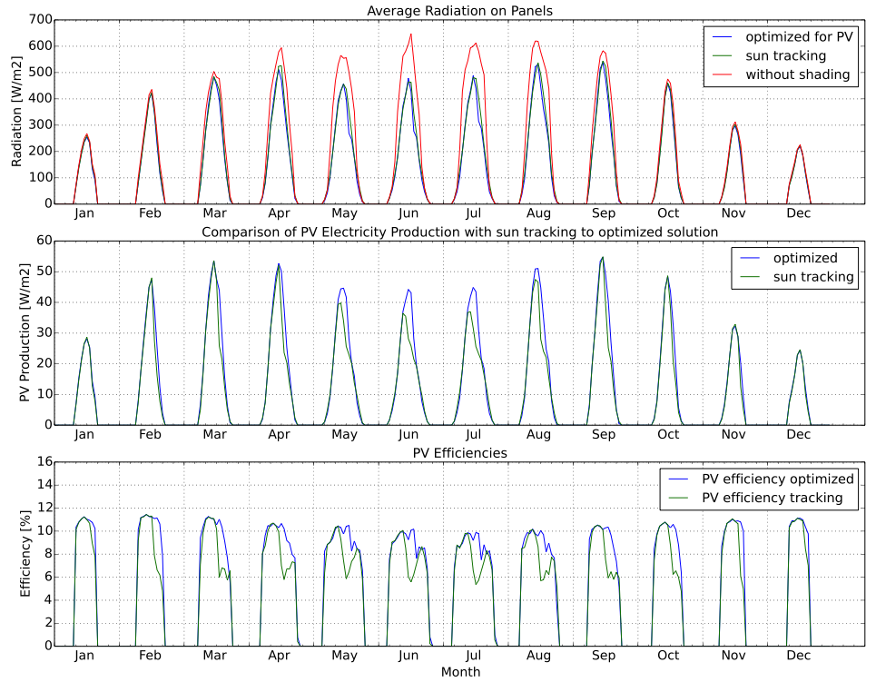
PV: Sun-Tracking vs. Optimization
- Similar Radiation
- Large Loss due to Shading
- Higher Electricity Production for Optimized Solution
- Higher Efficiency with Optimized Solution

Slide 13
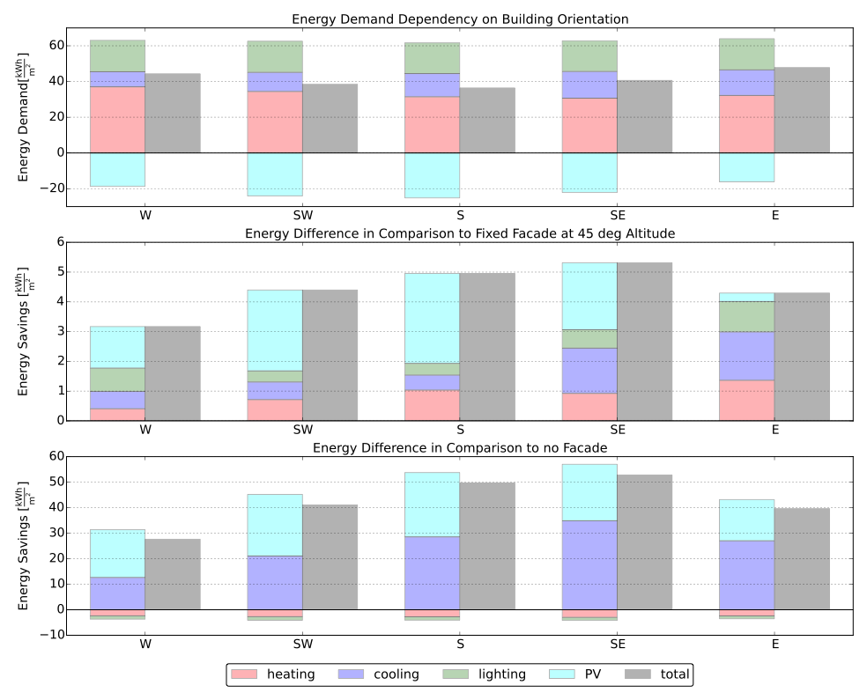
Building Orientation Performance
South facing office performs best
Highest benefit from ASF for south-east facing facade due to cooling

Slide 14
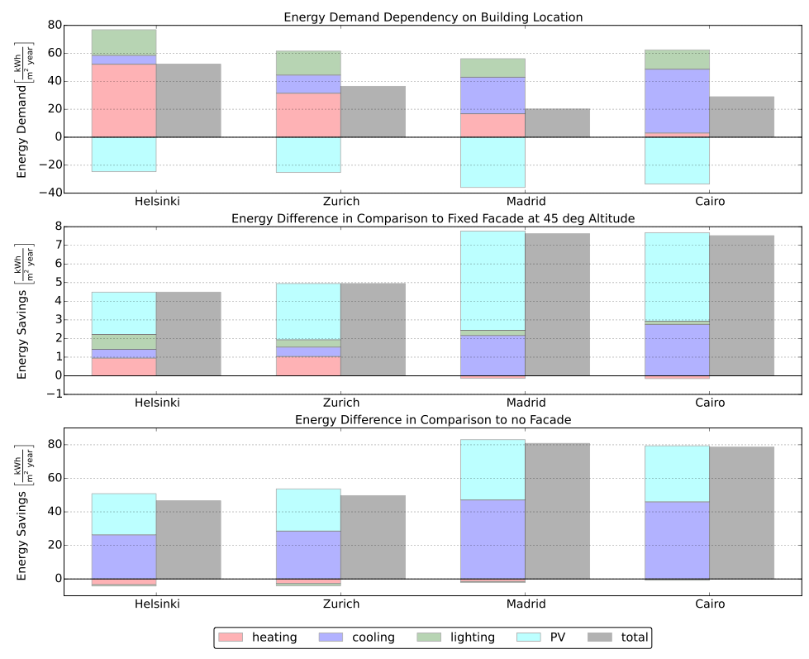
Building Location Performance
Office in Madrid performs best
Highest benefit from ASF for warm
Regions

Slide 15
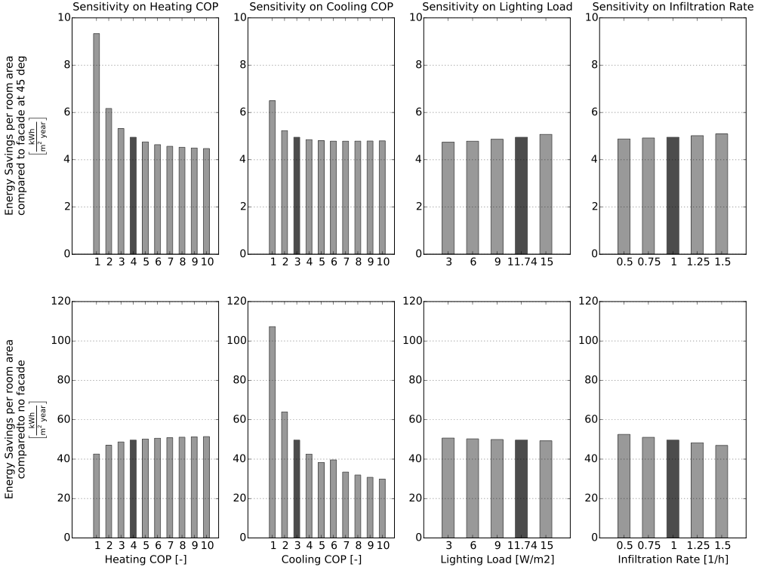
Building Parameter Sensitivity
High Sensitivity on
Heating / Cooling COP
Lower Sensitivity on
Lighting Load and
Infiltration Rate

Slide 16
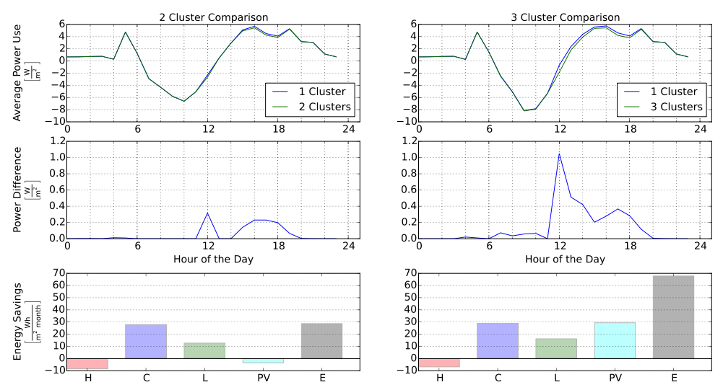
Cluster Analysis
2 Clusters
10 Panels for Radiation
5 Azimuth / 5 Altitude Angles
3 Clusters
8 Panels for Radiation
1 Azimuth / 5 Altitude Angles
June
1%
2.3%
Average of
Mar, Jun,
Sep, Dec

Slide 17
Conclusions
Developed Simulation Framework for the ASF
Successfully combine PV-Electricity Production with Building Energy Demand
Optimal Angles for Single Cluster Found

Slide 18
Outlook
Development of RC-Building Energy Simulation Tool (Collaboration with Mario and Amr)
Include detailed Efficiency Analysis of PV-Electricity Production (Collaboration with Johannes)
Include Energy-Use for Actuation in Simulation
Analyze Results for different Regions and Building Typologies
Use Multiple Clusters of PV-Panels

Slide 19
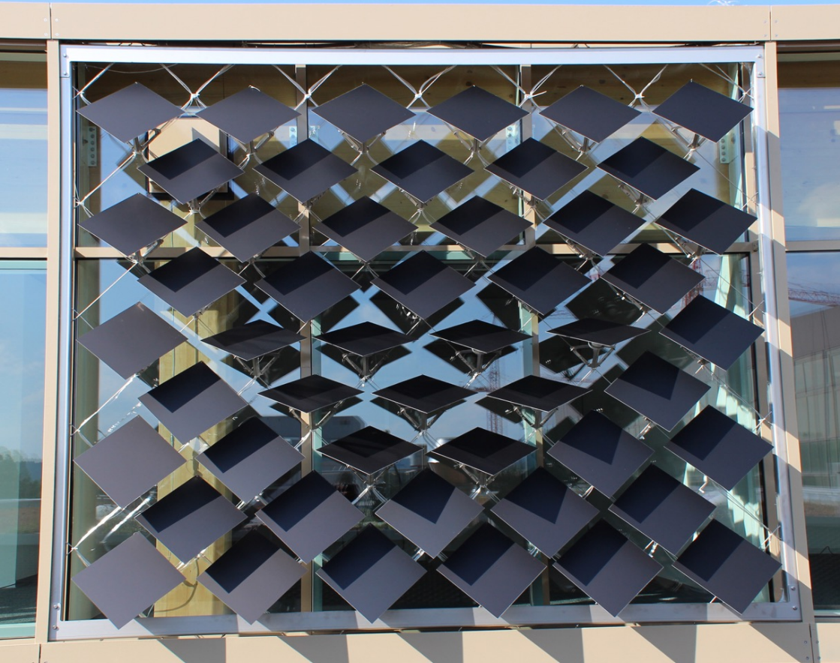
Questions?
https://github.com/architecture-building-systems/ASF_Simulation

Slide 20
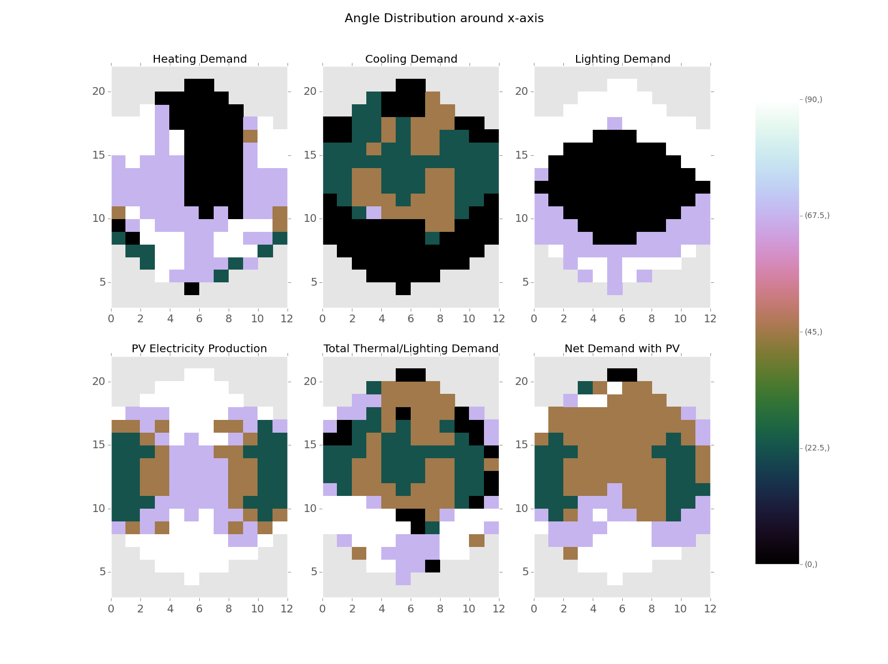
Developed Simulation Framework for the ASF
Optimum Angle Combinations Found
Possibility to Include PV-Electricity Production

Slide 21
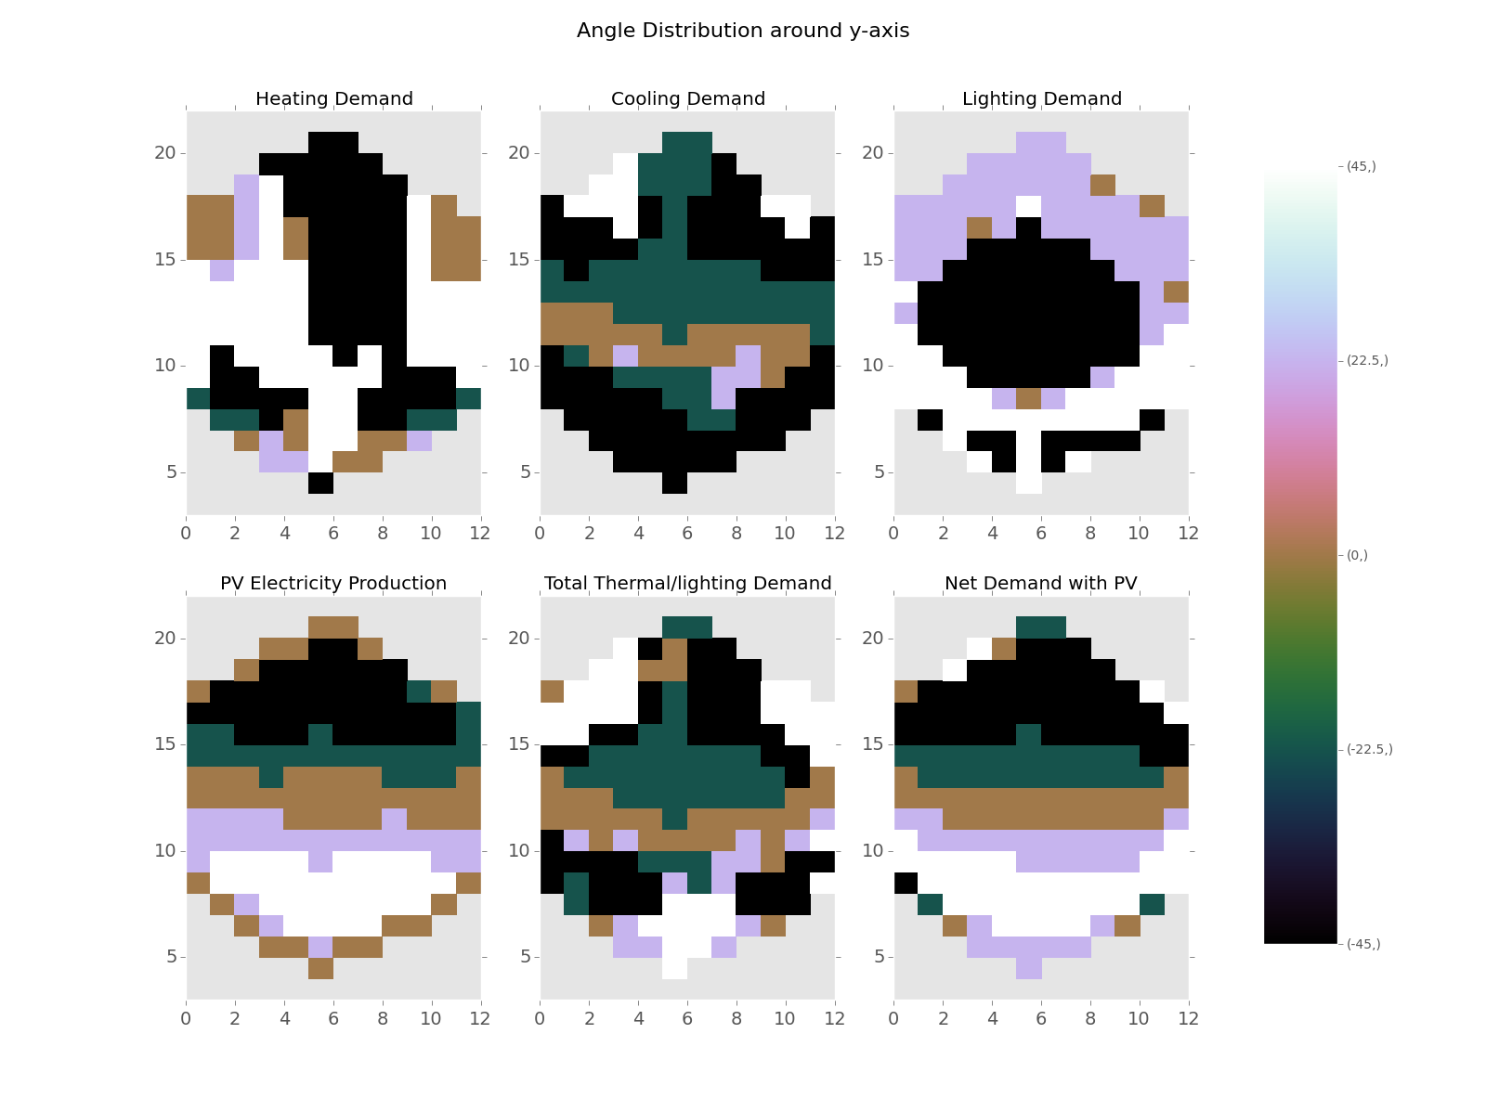
Developed Simulation Framework for the ASF
Optimum Angle Combinations Found
Possibility to Include PV-Electricity Production

Slide 22
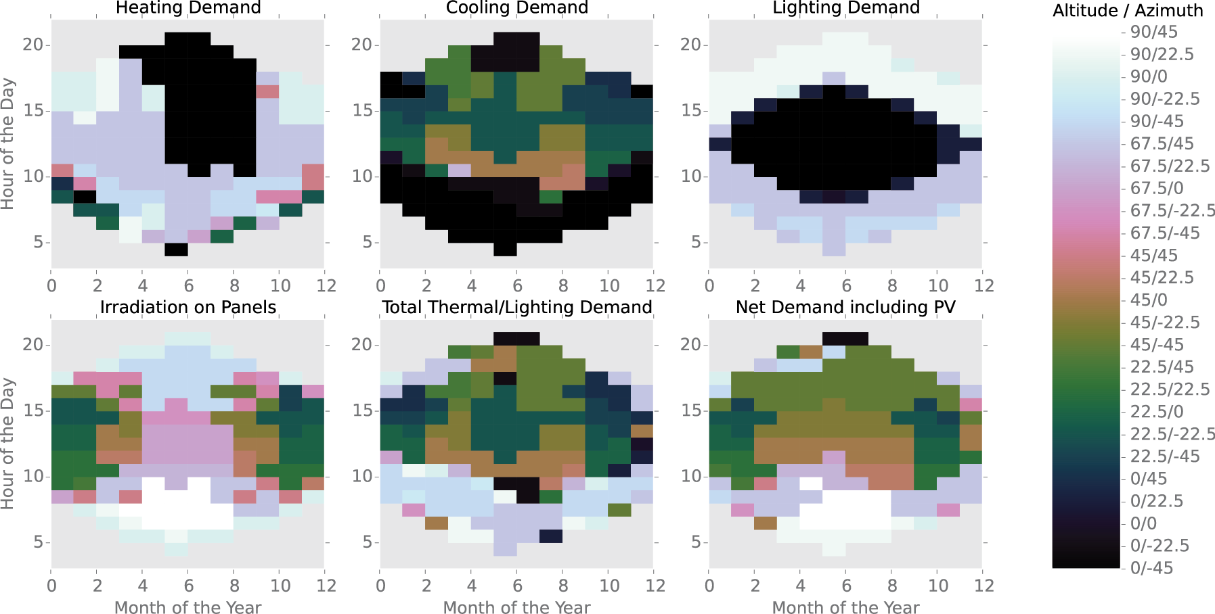

Slide 23
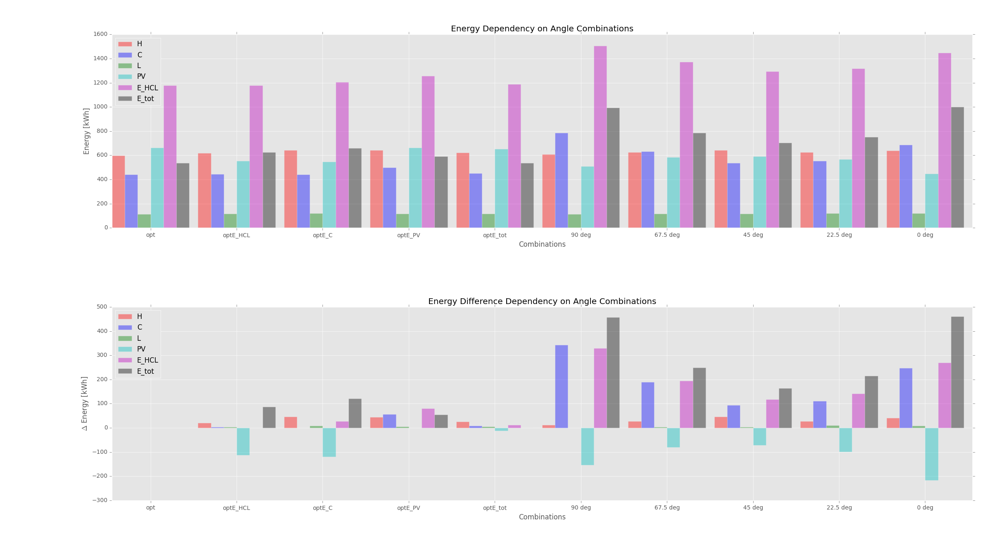
Heating COP = 3 Cooling COP = 3 Lighting = 3 W/m2 PV-efficiency = 0.072

Slide 24
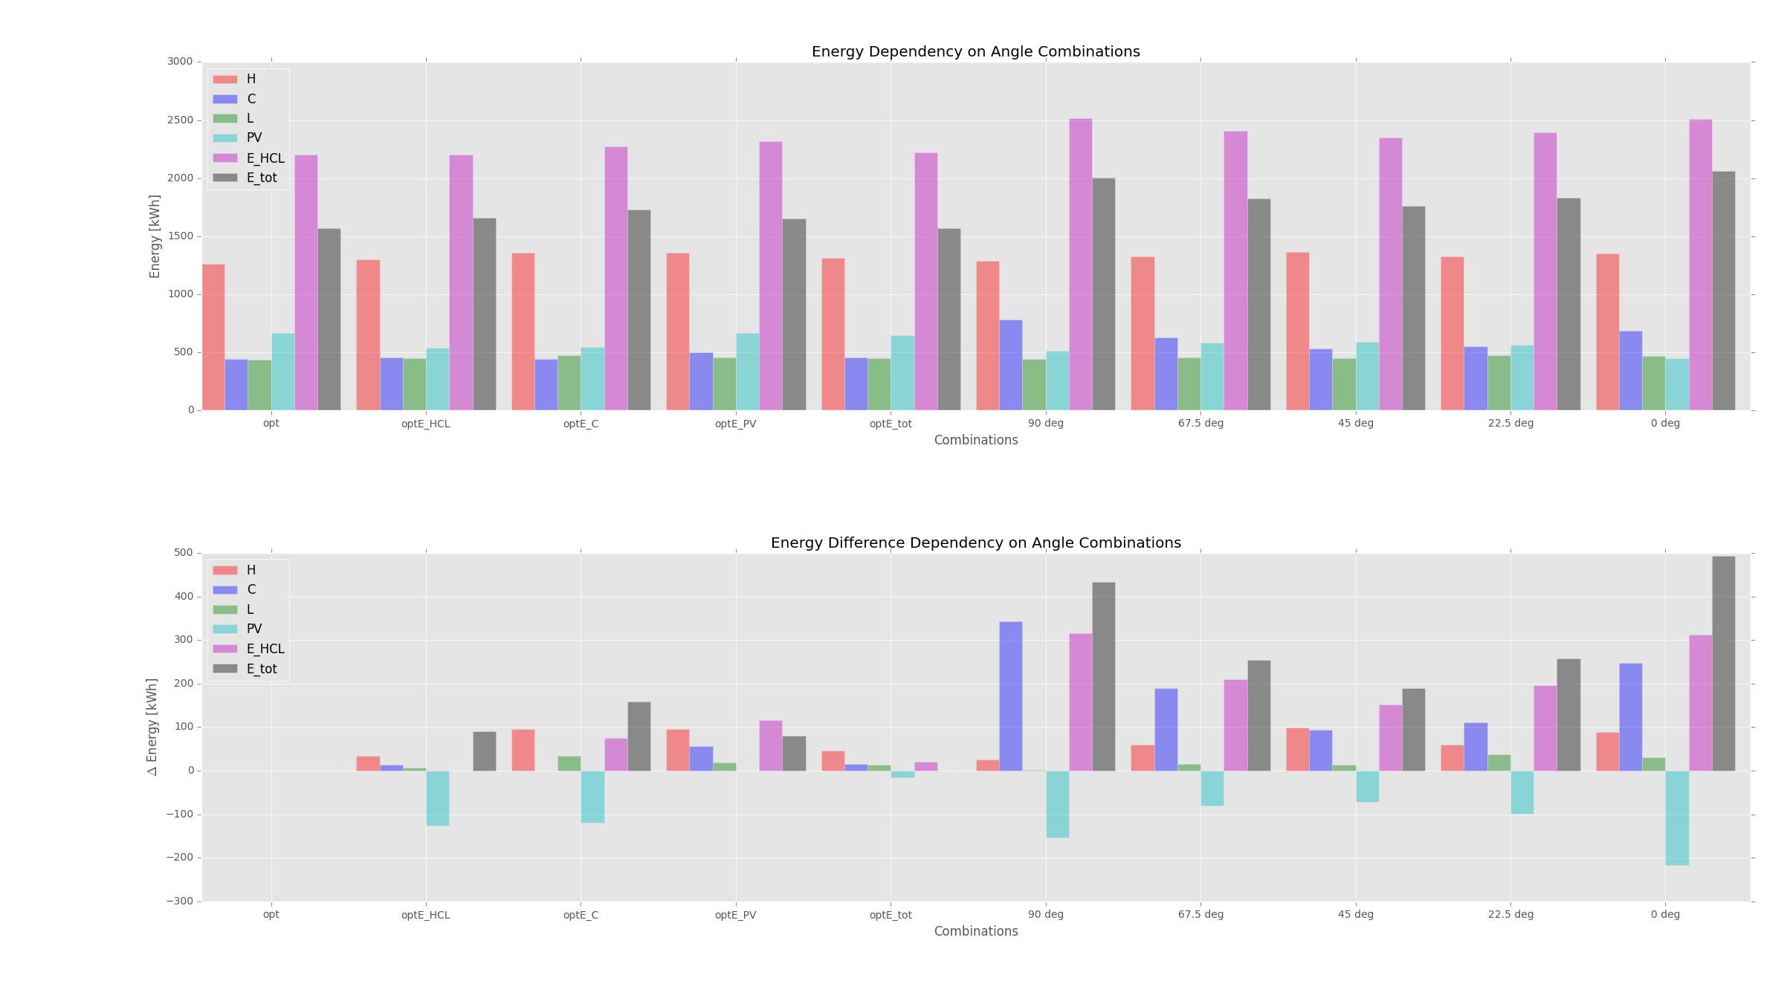
Heating COP = 0.85 Cooling COP = 3 Lighting = 11.74 W/m2 PV-efficiency = 0.072

Slide 25
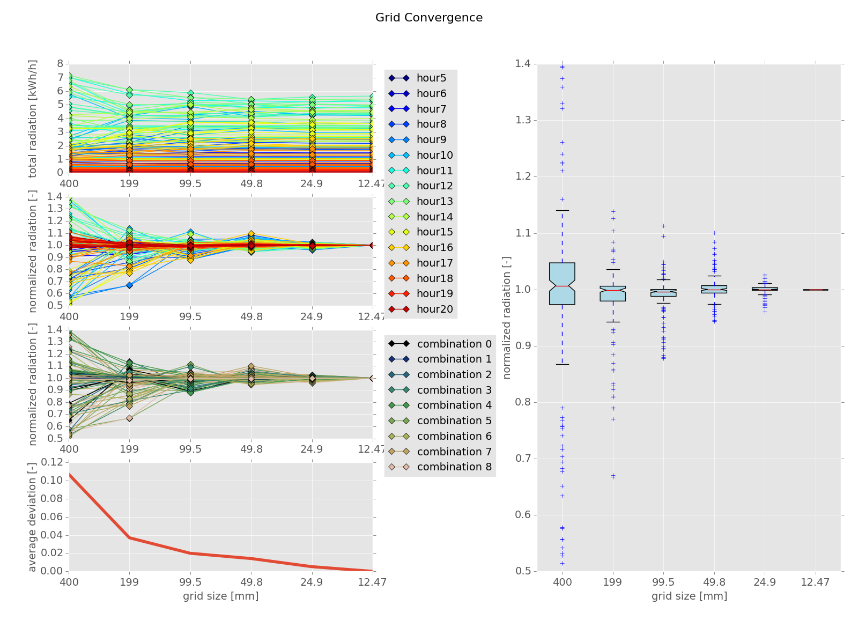
Conclusions
Developed Simulation Framework for the ASF
Optimum Angle Combinations Found
Possibility to Include PV-Electricity Production

Slide 26
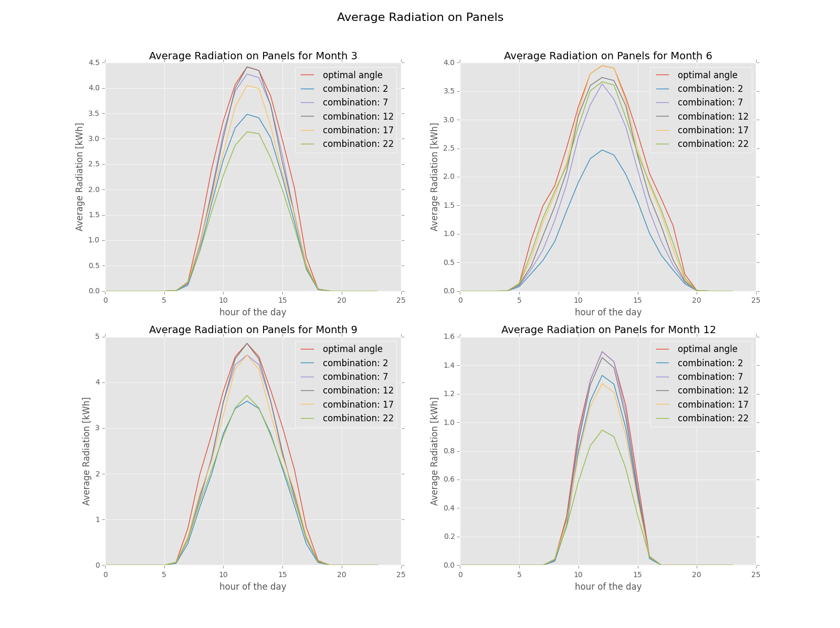
Conclusions
Developed Simulation Framework for the ASF
Optimum Angle Combinations Found
Possibility to Include PV-Electricity Production

Slide 27
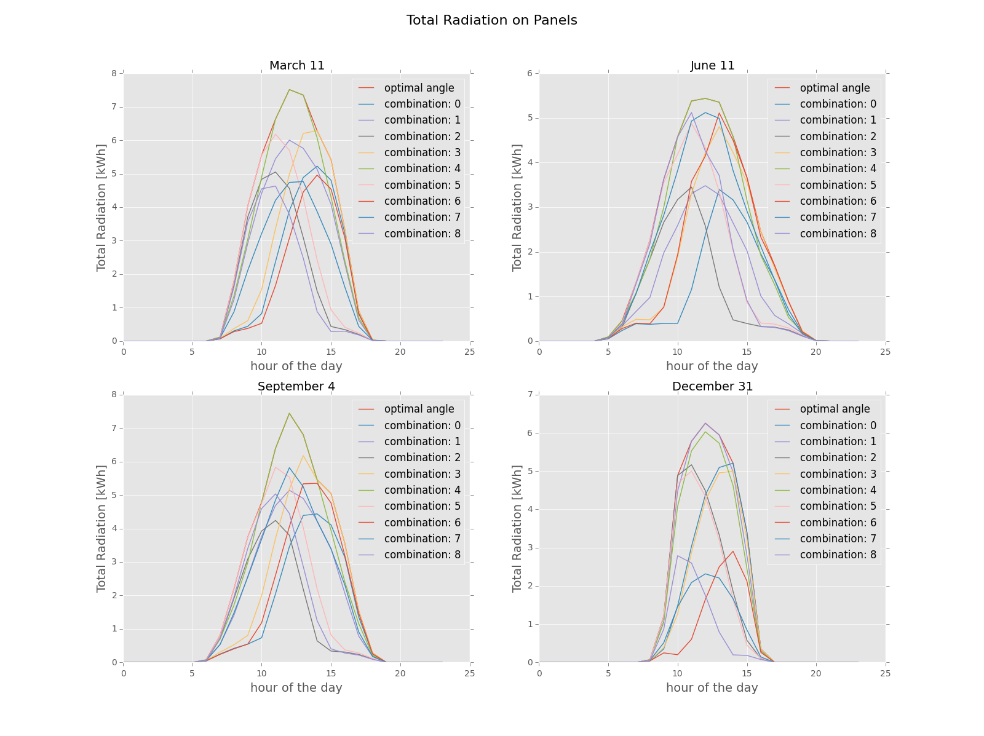
Conclusions
Developed Simulation Framework for the ASF
Optimum Angle Combinations Found
Possibility to Include PV-Electricity Production

